Slide 1
Farmers’ Market Overview
Training and Resource Center
Adapted from Esther Bush (Champions for Change)

Slide 2
Campus and Farmers’ Market Goals
Goal 1: Reach out to local Farmers’ Market to build partnership and see if EBT is available. If EBT is not available, ask for it to be and help if possible.
Goal 2: Establish partnership and develop a plan for promotion of the local market across campus. Such as, promoting through CalFresh Outreach, campus pantry, across campus social media, or doing a recipe tasting on campus using Farmers’ Market produce.
Goal 3: Organize Farmers’ market tours (market walks) to help students get familiar with how easy it can be to get to the market. Public transportation can be a great way to get from campus to the market.
Goal 4: Get creative for additional promotion of the market. See if your market has market bucks they could give to you to use as an incentive to get more students to attend.
Goal 5: Regularly use market produce for on campus nutrition education cooking demonstrations and tastings to always have a link to the Farmers’ Market.

Slide 3
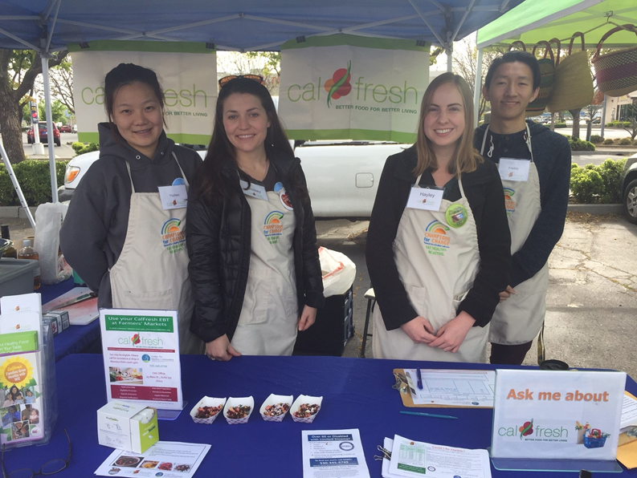
Interns Role at the FM
Interns and volunteers can assist with CalFresh Outreach, Nutrition Education, or general promotion.
Some roles could include: food prep, food safety, EBT machine, Market Match, CalFresh application, survey, market walks.
Intern at Market Manager Booth
Staff member can also be stationed at the Market Manager Booth to run the EBT machine and the market match program.

Slide 4
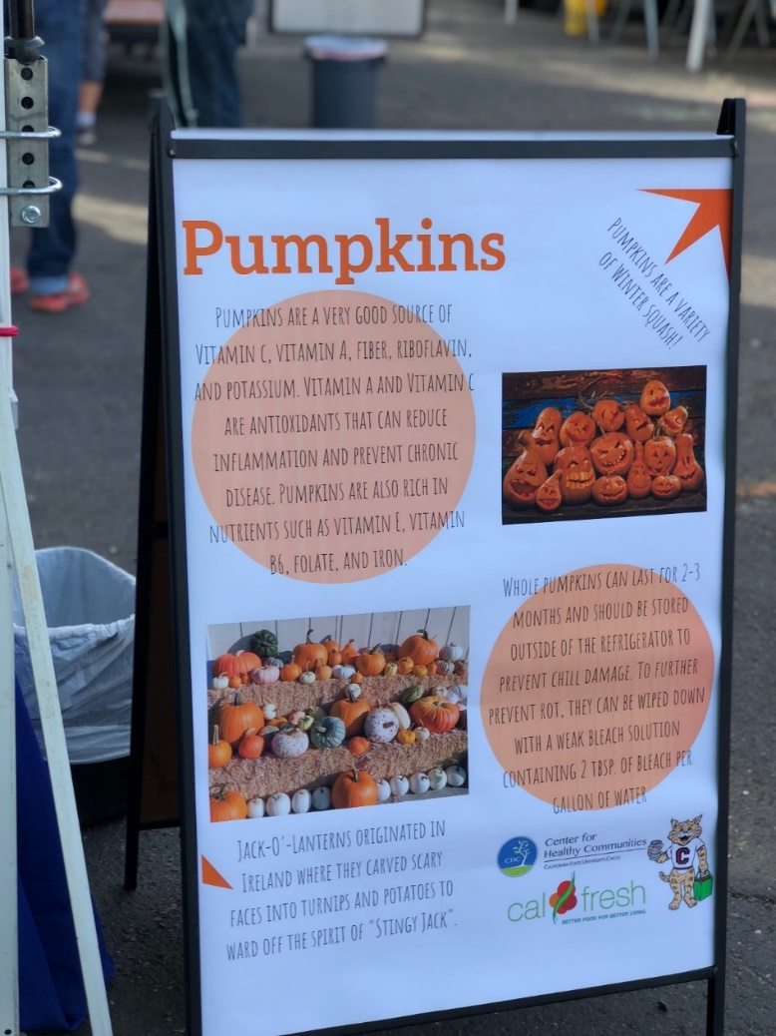
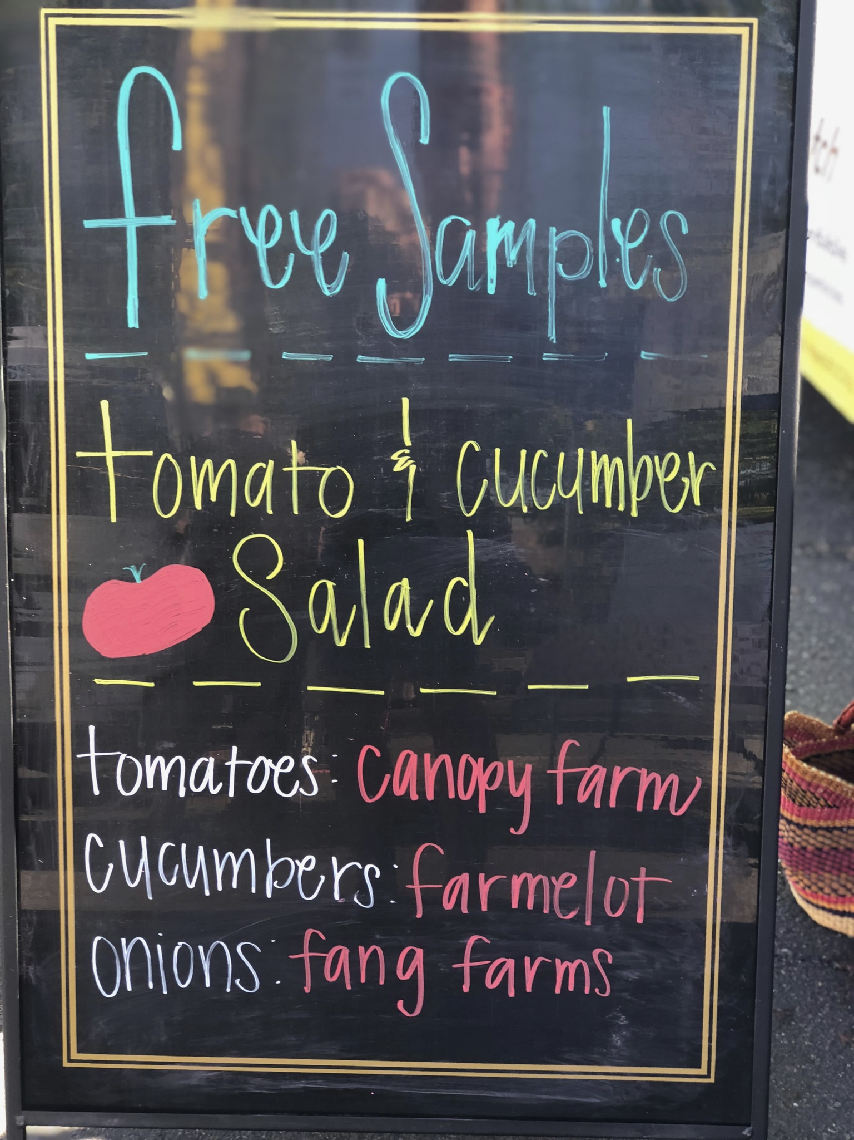
Examples of Signage
Notes:
Nutrition education and farmer promotion signage

Slide 5
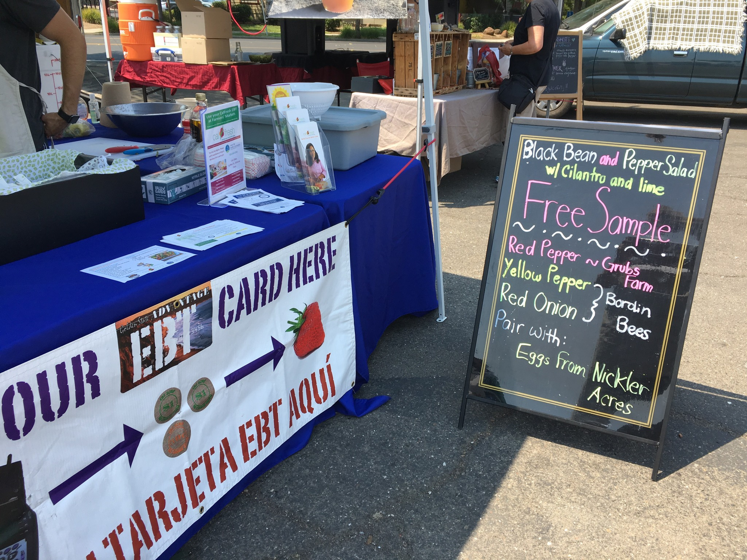
Notes:
CalFresh Outreach table display and signage for farmers/vendor booths

Slide 6
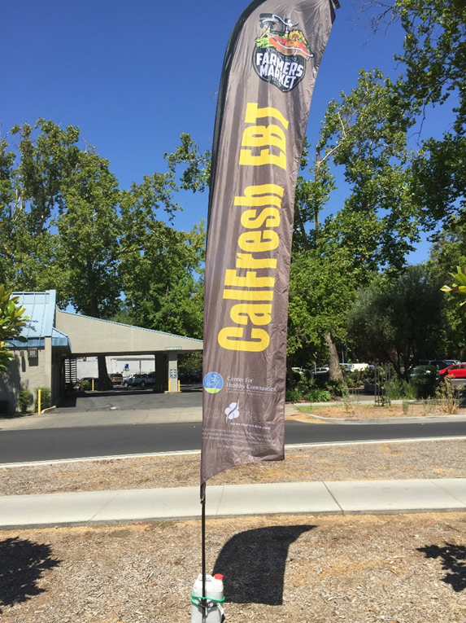
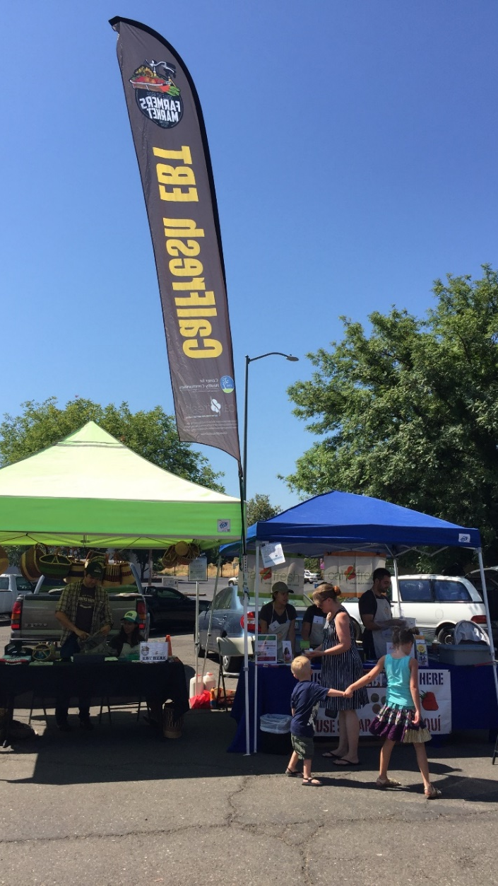
Notes:
Street level flags for promotion

Slide 7
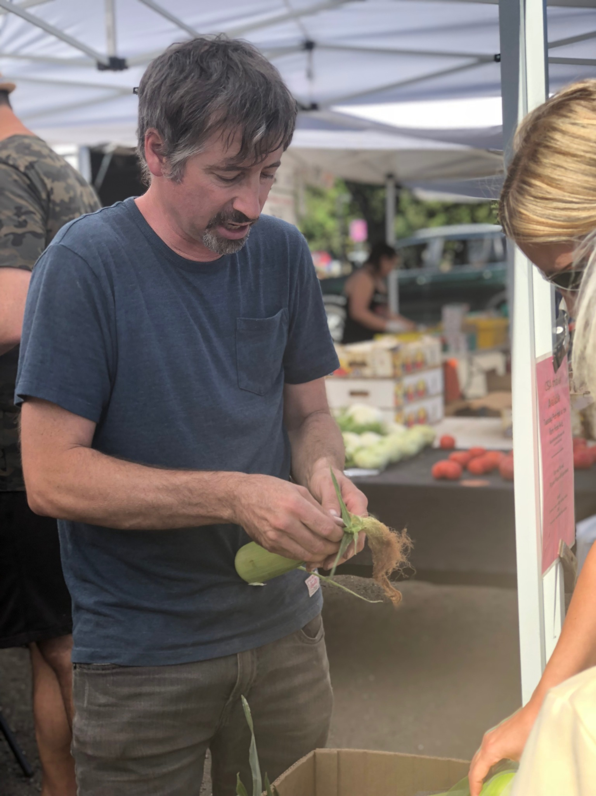
Market Walks/Tours
Promote at CalFresh Outreach, Pantry, and campus social media. Create an Eventbrite to determine attendance number.
Walk can be 15-60 minutes, flexible messages.
Model asking farmers/vendors questions about produce or tastings.
Introduce to farmers/vendors and share special facts.
Provide Farmers’ Market orientation and tips for using CalFresh EBT and Market Match tokens (If applicable).

Slide 8
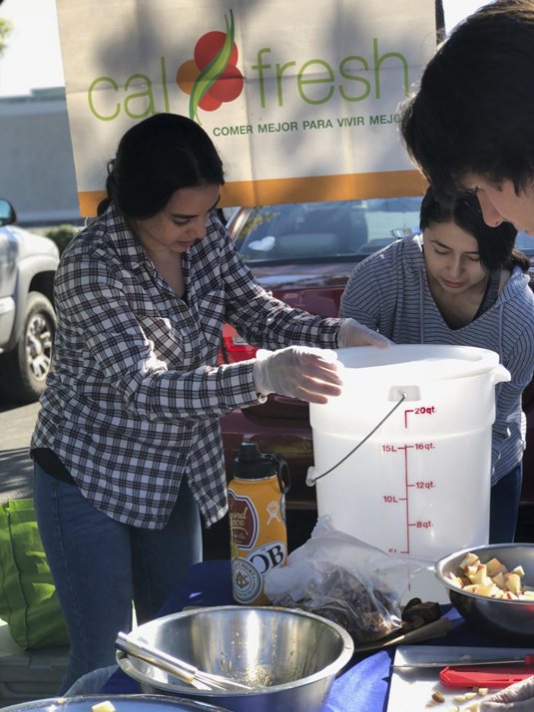
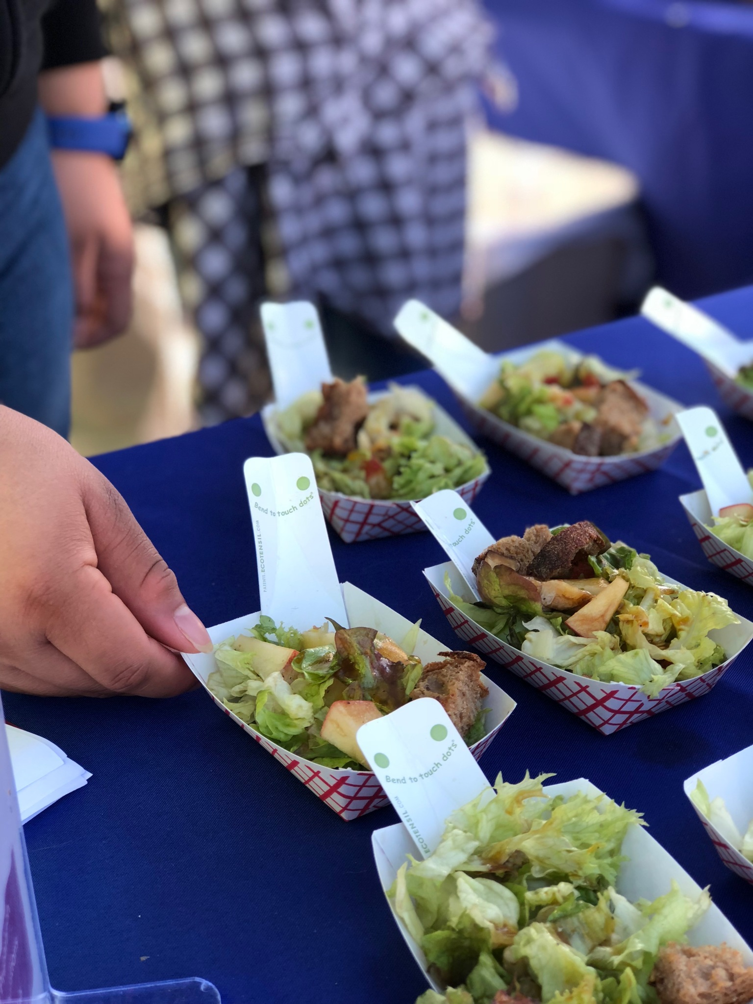
Cooking Demonstrations and Tastings
Notes:
Interns prepping tastings and tasting samples

Slide 9
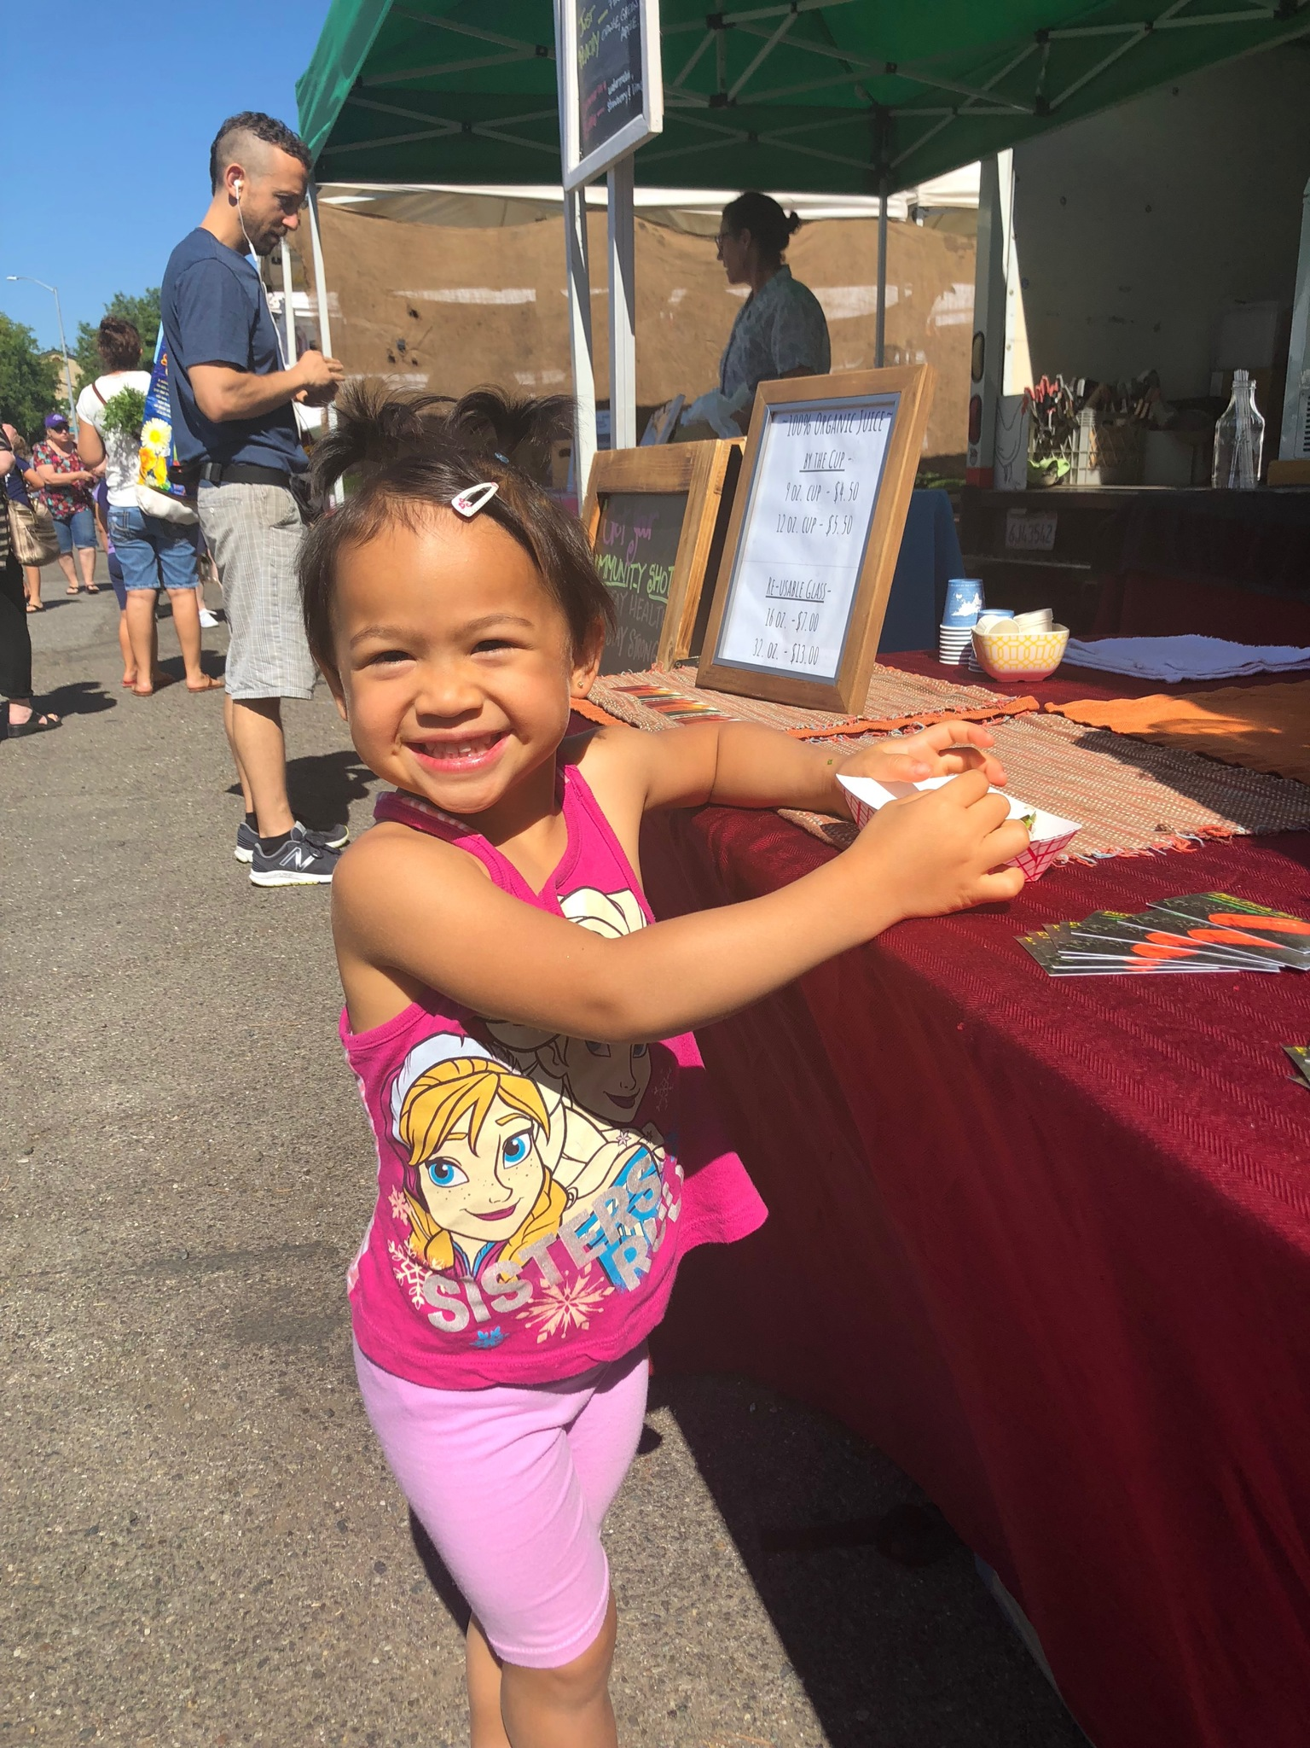
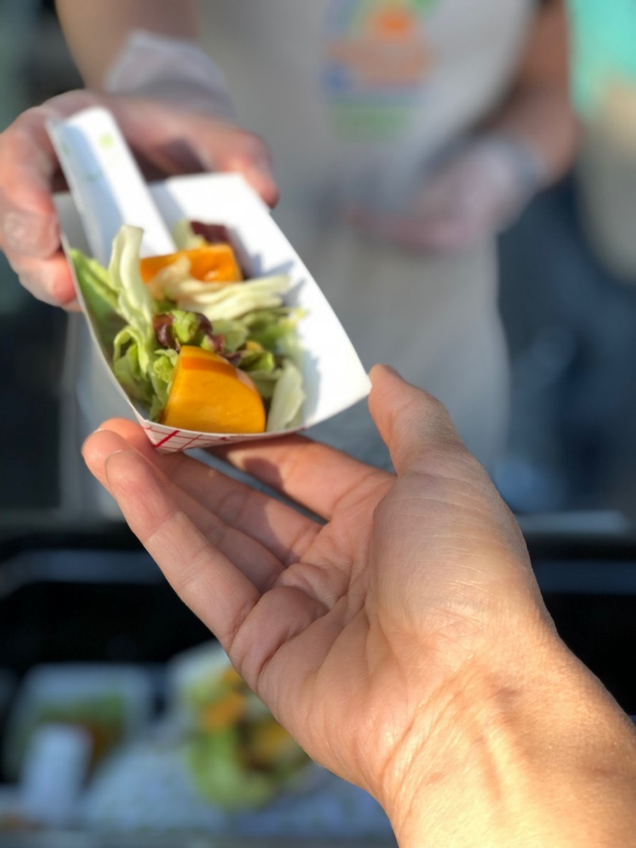
Tastings
Notes:
Weekly tastings

Slide 10
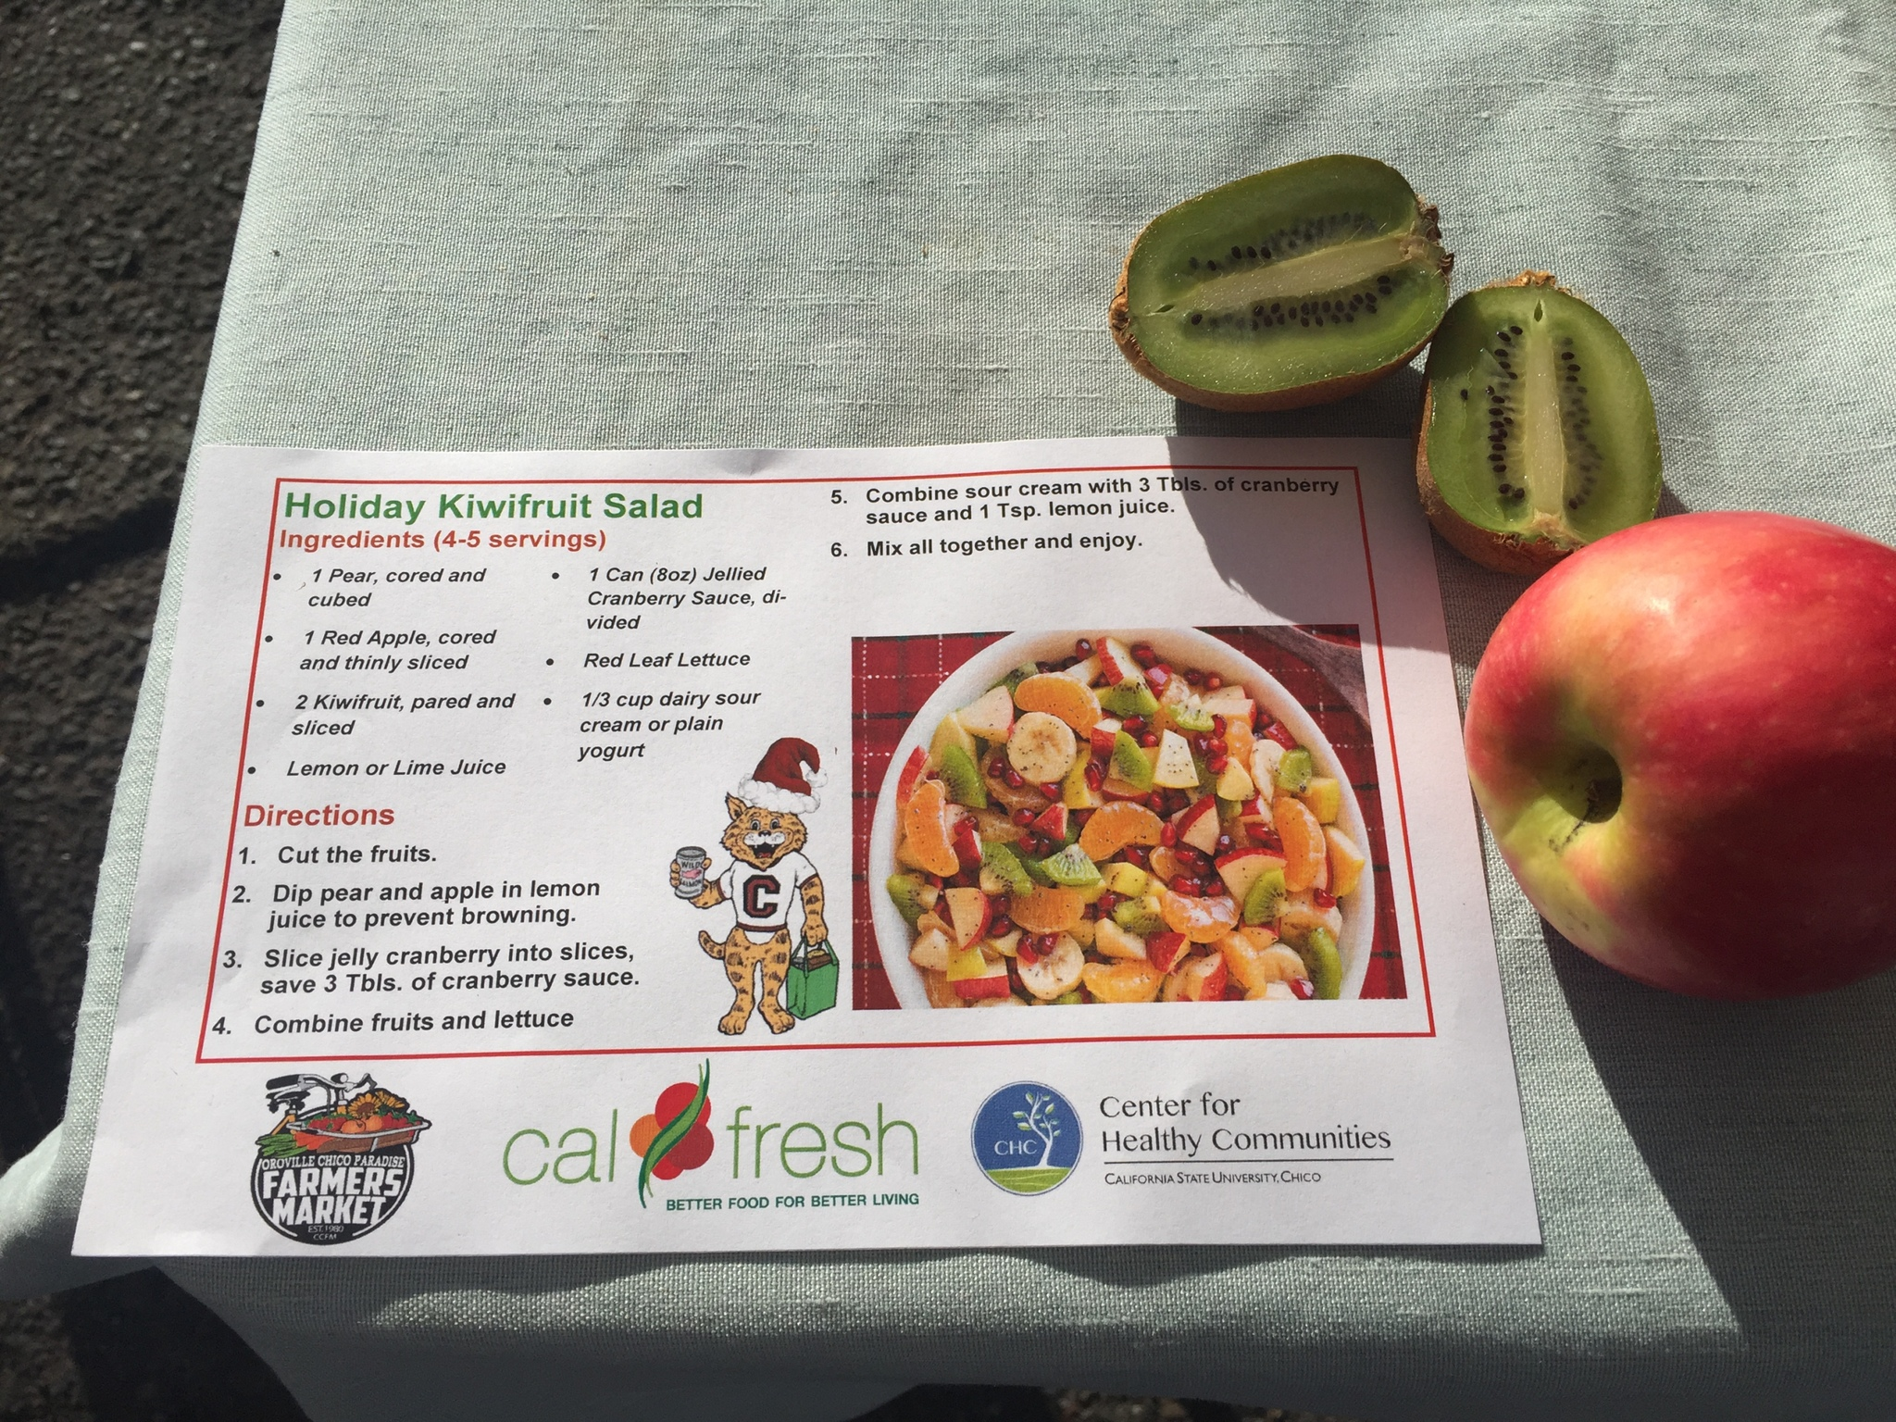
Recipe Cards
Notes:
Simple seasonally appropriate recipes

Slide 11
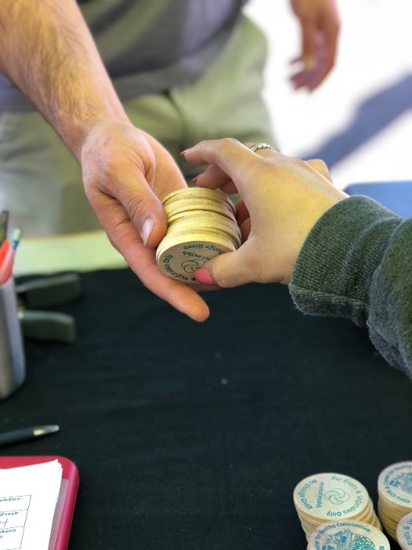
Market Match
Healthy food incentive program which matches customers’ federal nutrition assistance benefits at farmers’ markets, like CalFresh.
Ecology Center

Slide 12
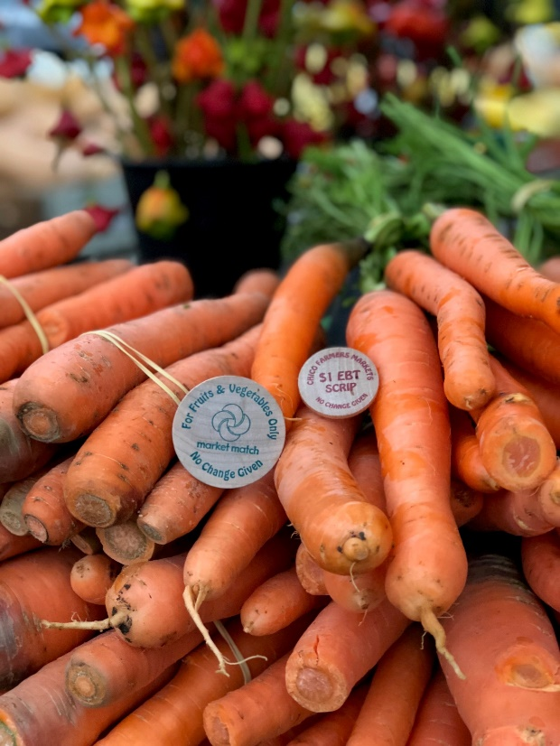
Contact Information
For Technical Assistance:
Web: CSUChico.edu/chc/
Email: CHC@CSUChico.edu
Phone: 530-898-5323

