Slide 1
CalFresh Outreach Far North & Higher Ed.
CALFRESH OUTREACH
FAR NORTH & HIGHER ED
Year 3 Program Reporting Updates Webinar
We will be starting in just a few minutes
If you are watching the webinar on your computer, but joined audio by phone, please mute your computer to avoid feedback
Use the chat box for questions or troubleshooting at any time

Slide 2
CFO Year 3 Program Reporting Updates
CALFRESH OUTREACH
FAR NORTH & HIGHER ED
Facilitators:
Natalie Jensen & Rebecca Berner
Promotional Materials and CalFresh Branding
Facilitators
Emily Foxworthy and Aaron Kunst
Funded by USDA SNAP, known in California as CalFresh, an equal opportunity provider and employer, and the California Department of Social Services.
Notes:
DO NOT MOVE GREEN TRIANGLE

Slide 3
1. Master log changes and how to use it
2. Program reporting resources
3. Follow-ups using 51% approval
4. Program reporting timeline
5. Review and wrap up
Agenda
Today’s Topic and Goals

Slide 4
Prescreen could be: an online form, active conversation, or in the GetCalFresh.org application
Prescreen is not: posting or sending out flyers about eligibly info without a conversation
Prescreen
A prescreen is any exchange of information that would help to determine CalFresh
Eligibility.
If you prescreen the same person more than once, you may count each instance as an individual prescreen.
Notes:
Definition of Prescreen:
Updated Materials on website, reach out to PM
Examples of instances where a client is prescreened multiple times? Ex: you do a virtual event and go through prescreen questions with all participants, then each participant goes through a CF application, each student would have been prescreened twice?

Slide 5
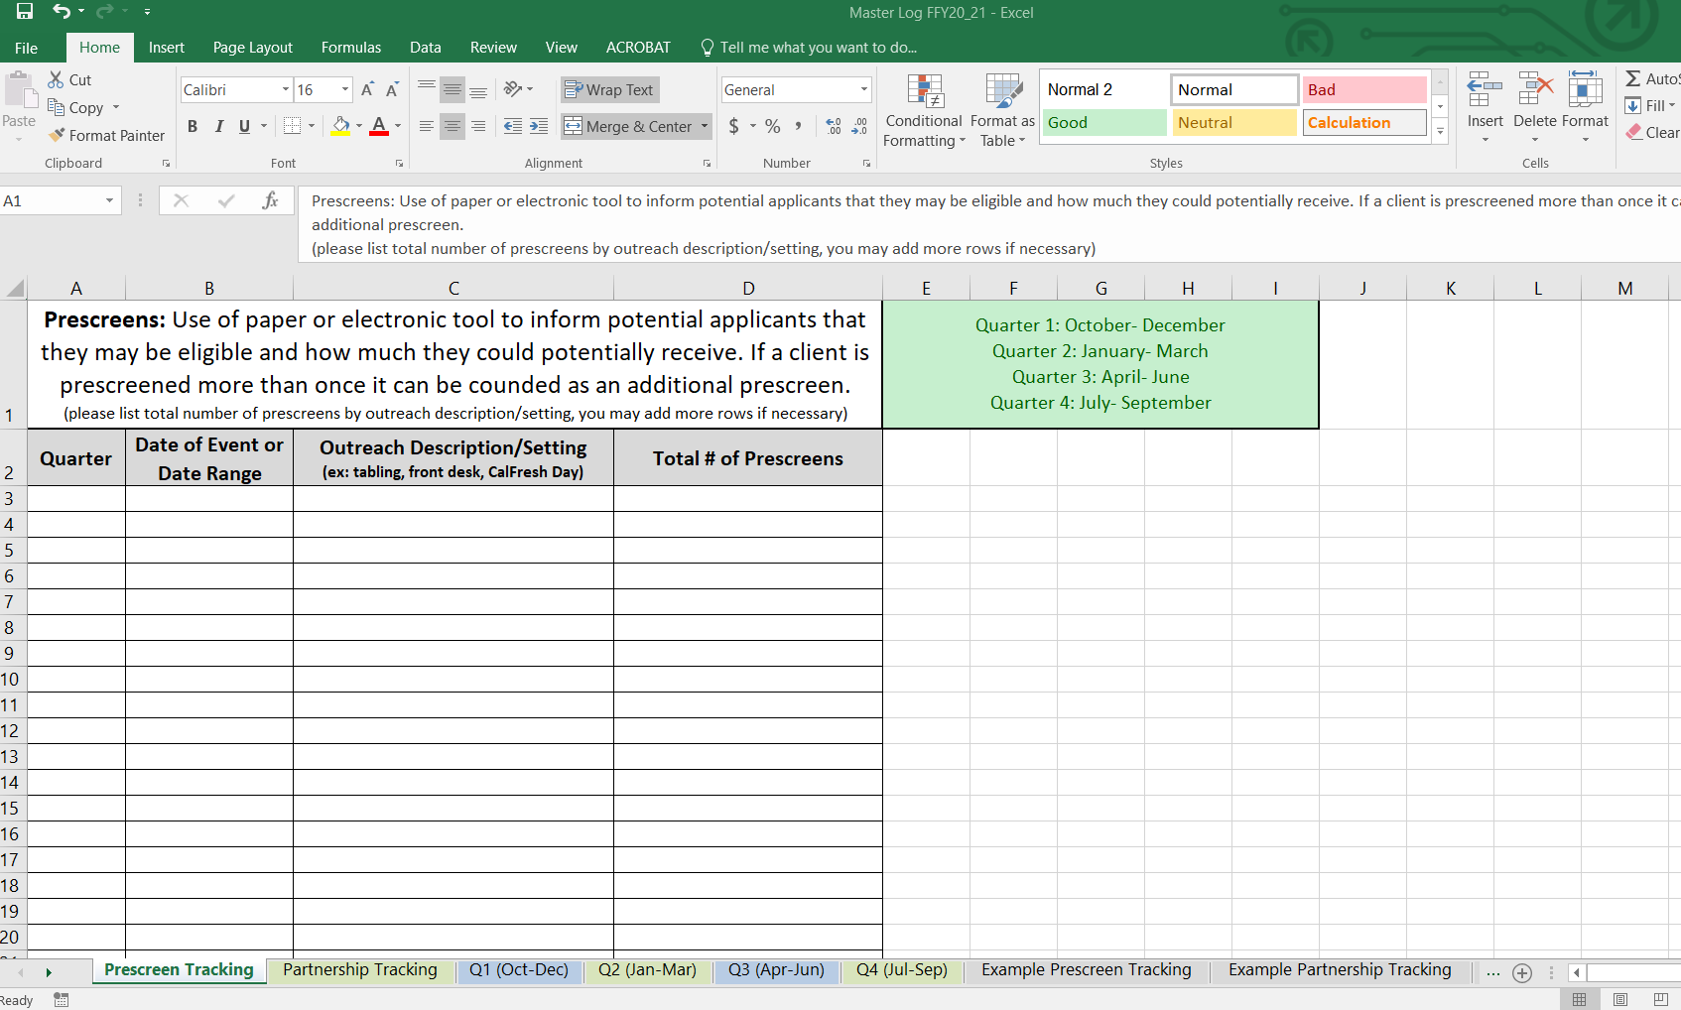
Notes:
Insert picture of Prescreen Tab of Master Log

Slide 6
Prescreen Tracking
Notes:
Counting prescreens through Referral URL:
-each Referral URL app counts as a prescreen

Slide 7
Partnership could be: with departments on a campus, counties, stakeholders, or efforts with programs like WIC and Medi-Cal
Partnership is not: an internal team meeting
Partnership
A partnership is a training provided by you or a collaborative meeting to provide information or education on CalFresh.
You can count monthly recurring meetings with the same partner as individual partnerships.
Notes:
Definition of Partnership:
Explain how you can count multiple meetings or trainings with the same partner

Slide 8
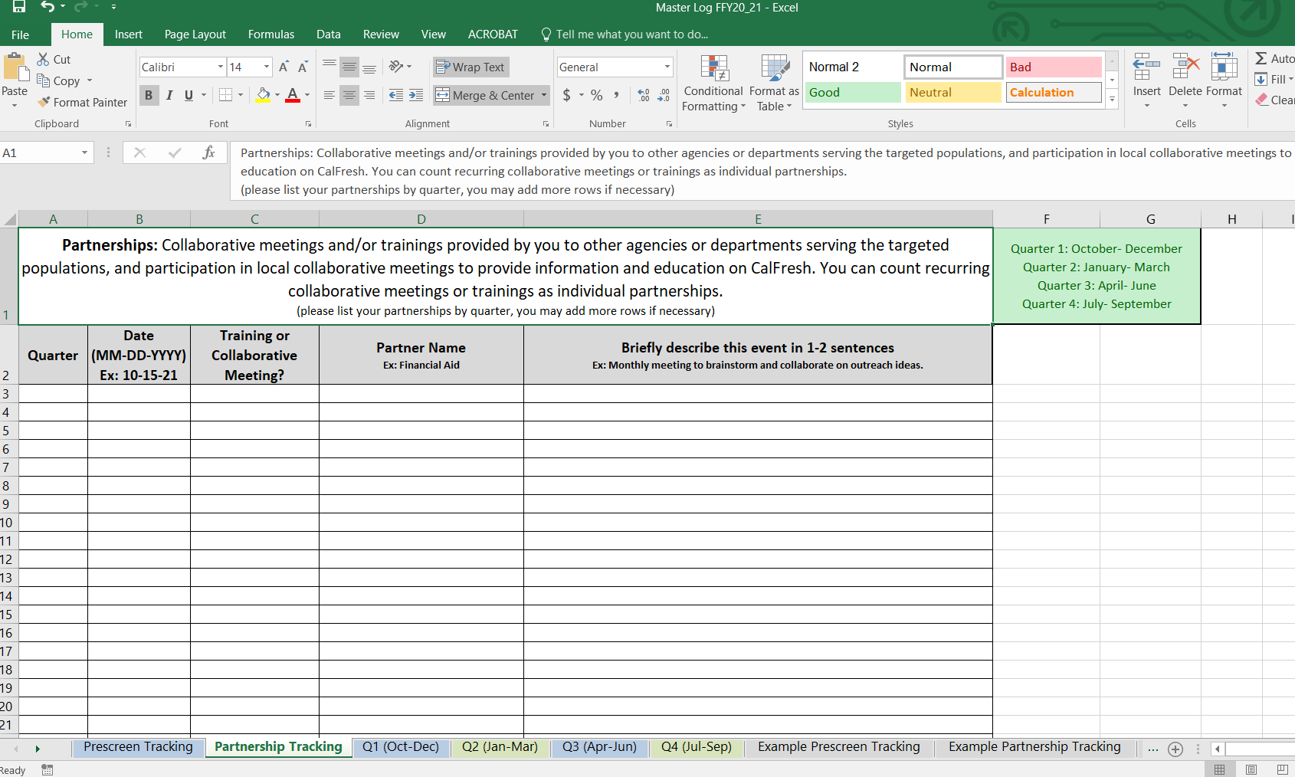
Notes:
Insert picture of Partnership Tab of Master Log

Slide 9
Partnership Tracking

Slide 10
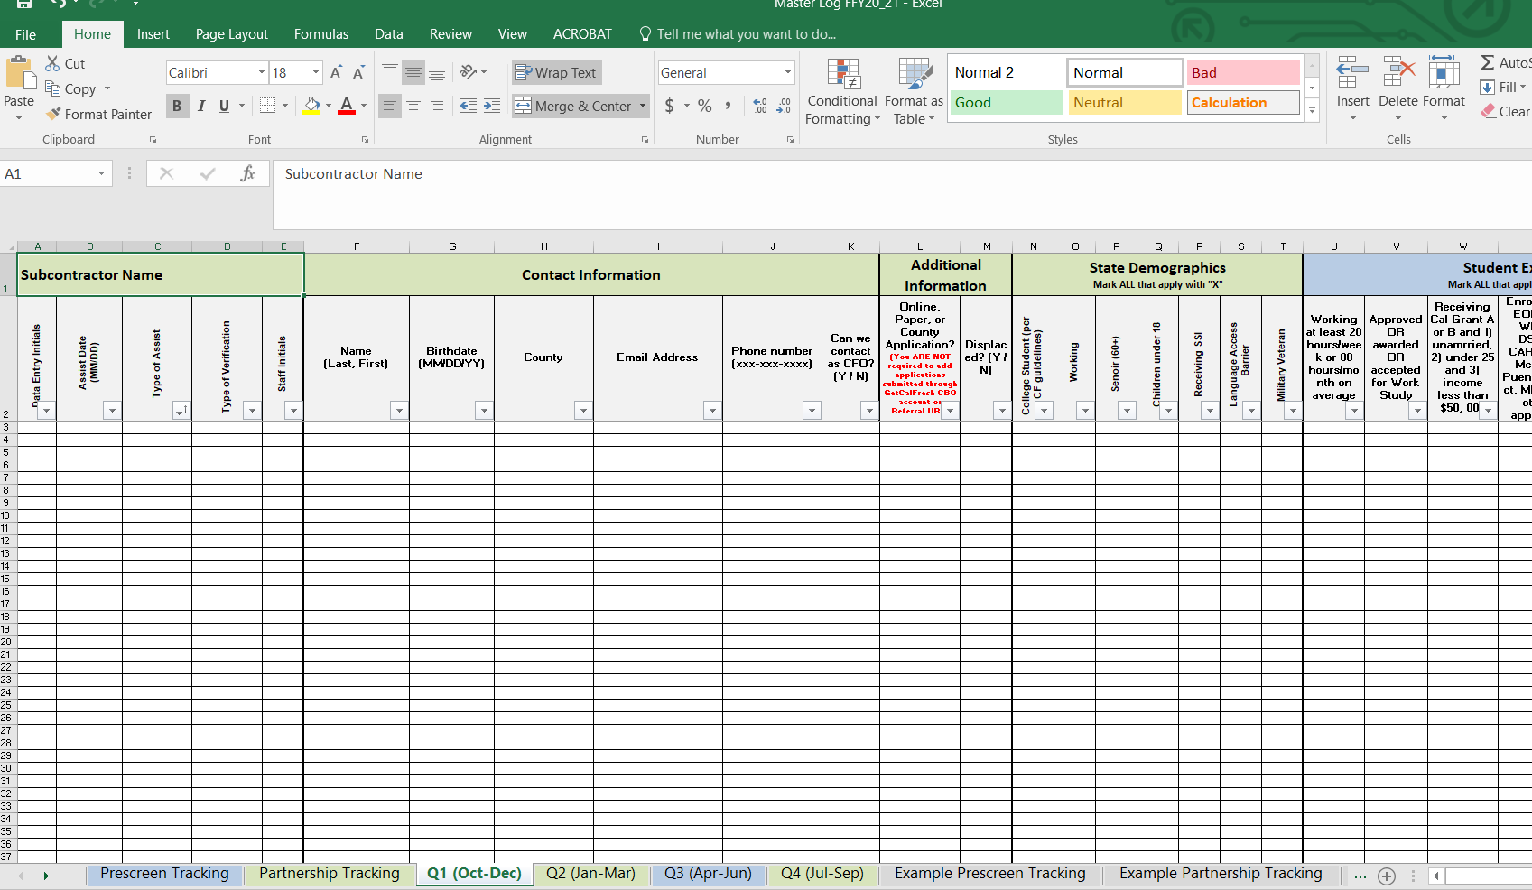
Notes:
Screenshot of quarter tab in the master log

Slide 11
Quarter Tab - Applications Submitted
Tracking applications submitted in the quarter tabs of the master log may or may not be required depending on how they are submitted.

Slide 12
Quarter Tab - Applications Submitted
If you submit applications through your GetCalFresh assistor sign in or Referral URL:
If you submit applications through C4Yourself, CalWIN, YBN, Paper, or county worker:
You are NOT REQUIRED to input the applications into the quarter tab
You MUST enter applications into the quarter tab

Slide 13
Quarter Tab - Verifications
Please report any verifications (SAR7 or RE) submitted on behalf of a client in the quarter tab.

Slide 14
Follow-ups
California Department of Social Services (CDSS) has approved the use of an overall approval rate that is generated from monthly CalWIN custom state reports.
You can do follow-ups in the following ways:
GetCalFresh case notes
External document
Master log
You no longer need to report case notes or outcome data
It is still important to conduct follow-ups with your clients
Notes:
Blurb about using overall % for approval rate

Slide 15
Summary
The master log is used to track the following contract deliverables:
Prescreens
Partnerships
Applications submitted via: C4Yourself, CalWIN, LRS, paper, or county worker
Verifications (SAR7 & Recertification)
You are no longer required to report outcome data.

Slide 16
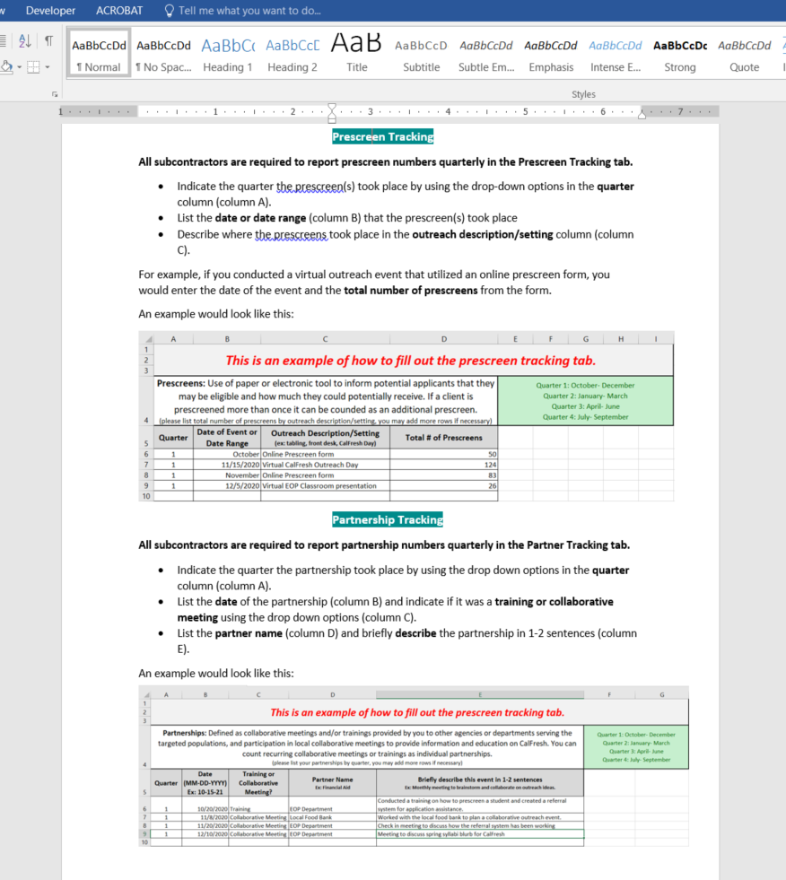
Year 3 Master Log Instruction Guide
Notes:
Show picture of guide or show where they can find it on website?

Slide 17
Reporting Timeline FFY 2020-2021
Quarter 1 (October-December 2020) due January 15th
Quarter 2 (January- March 2021) due April 15th
Quarter 3 (April-June 2021) due July 15th
Quarter 4 (July-September 2021) due October 15th
Notes:
Blurb about using overall % for approval rate

Slide 18
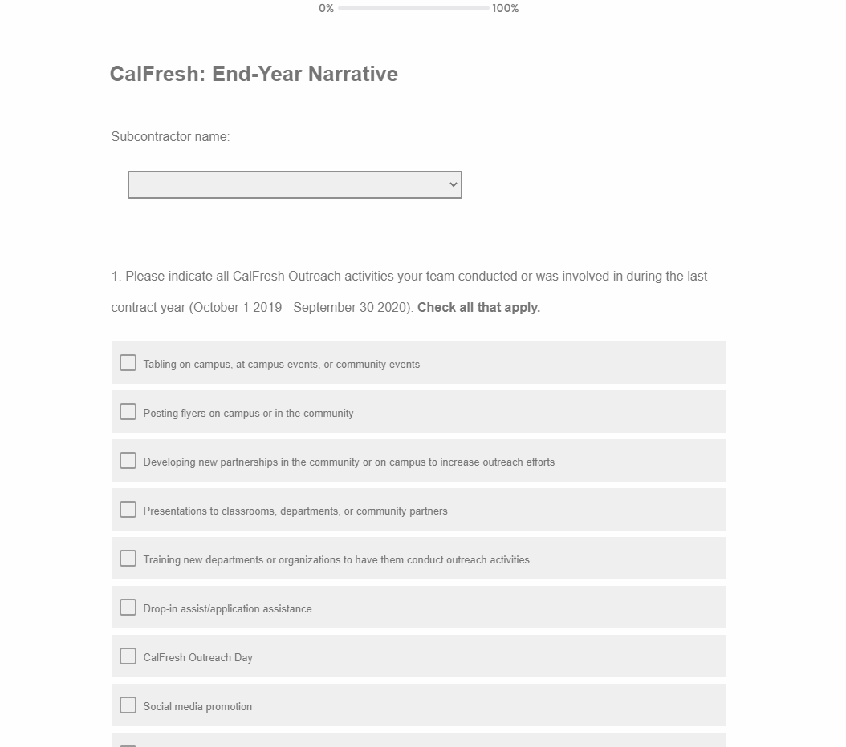
Online Narrative Form
The mid-year narrative is due Q2​
The end-year narrative is due Q4

Slide 19
Quiz Time!
Notes:
Wrap up slide and FAQ section

Slide 20
Evaluation Survey
Notes:
Wrap up slide and FAQ section

Slide 21
Thank You!
Contact Information
Please reach out to your Program Manager/Fiscal Analyst
OR
CHCCalFreshOutreach@csuchico.edu

