Slide 1
CalFresh Outreach Program 101
Program Basics

Slide 2
What is CalFresh Food?
Funding: Farm Bill to USDA FNS to CDSS
Supplemental Nutrition Assistance Program (SNAP)
Eligible households receive an Electronic Benefit Transfer (EBT) card

Slide 3
What can you buy with CalFresh Food?
Groceries – anything with a nutrition label
Supermarkets, convenient stores, farmers’ markets
Seeds and seedlings
Cannot purchase non-food items – cleaning supplies, cookware, items with a supplemental label

Slide 4
Restaurant Meals Program (RMP)
Individuals 60 years old or older, with disabilities, or experiencing homelessness
CalFresh Food benefits may be used at participating restaurants
RMP recently expanded to include all counties

Slide 5
Why do we do outreach?
Many Californians qualify but are not participating
$2.1B annually
$3.2B into the economy
Economic Impact:
350 x $250 x 12 = $1,050,000
$1,050,000 x 1.5 = $1,575,000

Slide 6
CalFresh Outreach Program 101
County Relationship

Slide 7
CalFresh Outreach (CFO)
Share CalFresh Food information
Assist eligible households apply and help them through the application process
Partnerships

Slide 8
County Roles
Process applications
Conduct interview
Request and review verifications
Determine eligibility
Notify household of approval or denial

Slide 9
Release of Information (ROI)
When calling the county with the client, they can give verbal consent for you to speak with the county
ROI is needed if the client is not with you while you are communicating with the county

Slide 10
Building and maintaining relationship
Regular communication
Invite to outreach events and team trainings
Inform county of possible influx of applications
Identify who on your team is the main communicator

Slide 11
CalFresh Outreach Program 101
Expedited Service

Slide 12
Expedited Service
Able to receive CalFresh Food benefits in three days or less
Must meet one of the following:
Have less than $150 of gross monthly income and less than $100 of cash on hand or in their checking or savings accounts; or
Have housing costs (rent/mortgage and utilities) that are more than their monthly gross income and cash on hand or in their checking or savings accounts; or
Are a migrant or seasonal farm worker household with less than $100 in their checking and savings and their income has stopped, or their income has started but they don’t expect to get more than $25 in the next ten days.

Slide 13
Expedited Service
Interview and identification required
Able to receive benefits before turning in additional verifications
Necessary verifications must be turned in to receive continuing benefits

Slide 14
CalFresh Outreach Program 101
Eligibility

Slide 15
Household
People who buy and prepare meals together
Additionally,
Married couple living together
Children under 22 living with biological, step, or adoptive parent(s), or
Unmarried couple living with a common child

Slide 16
Review the below and determine household size
Client reports living with two roommates, and tells you that they do not purchase and prepare food together
Client is 19 years old and reports living with both parents, and tells you that they do not purchase and prepare food together
Household of 1, as they do not purchase and prepare food together
Household of 3, as client is under 22 and living with parents

Slide 17
Income
Typically, income that is counted for CalFresh Food includes:
Wages from a job, including wages from self-employment
Rental income
Stipends
Foster Youth benefits if they are received directly
Social Security and state disability benefits
Spousal or child support
Unemployment benefits

Slide 18
Income cont.
Typically, income that is not counted for CalFresh Food includes:
Financial Aid programs
Income from Work Study job
Personal loans that need to be repaid
Irregular or infrequent cash gifts such a birthday money
One-time lump sum such as a tax refund

Slide 19
Income cont.
Reminder:
Even though some types of income may not be counted, clients should always report all income and income sources to the county as the county will be reviewing the verifications and the case to make an eligibility determination.

Slide 20
Review the below and determine possible gross income
Client reports receiving $100 monthly from a family member and gross $1600 monthly from their job a bookstore
Client reports receiving gross $600 monthly from their Work Study job on campus and gross $500 from their job at a coffee shop
Gross income is $1700.
Gross income is $500 from the job at a coffee shop. Income from Work Study is not counted but should still be reported to the county.

Slide 21
Student Eligibility
In addition, students must meet an additional criterion, also known as student exemption, to be eligible
“Student” – person enrolled in at least half-time and between the ages of 18-49

Slide 22
More Common Exemptions
Working and getting paid for at least 20 hours per week or 80 hours per month on average
Approved, awarded, or accepted Work Study
Receiving Cal Grant A or B and have a California Student Aid Commission (CSAC) letter

Slide 23
More Common Exemptions cont.
Enrolled in programs that increase employability
EOP(S), WIOA, DSPS, CARE, McNair, MESA, Guardian Scholars, FYSI, CAFYES, or Extended Foster Care
Additional programs can be added if they are submitted to the state and are approved. See description for a comprehensive list of approved programs.

Slide 24
Other Exemptions
Having parental control of a child under the age of 6, between 6-12 without adequate childcare determined by the county, or be a single parent of a child under the age of 12
Participating in the CalFresh Employment and Training Program, JOBS, or receiving CalWORKs

Slide 25
Things to note:
International, DACA, and DREAM students are not eligible
Out-of-state students may be eligible if they are residing in California
Students with a disability do not have to meet an exemption
If they are on a campus meal plan and are provided less than half, which is 10 or less, meals per week, they most likely may be eligible for CalFresh Food

Slide 26
CalFresh Outreach Program 101
Prescreen

Slide 27
What is a prescreen?
“Prescreen” – technical term for those on the CFO contract
Assessment or conversation with potential applicants to assess whether their household look to be eligible

Slide 28
Prescreen - bit.ly/2022prescreen
Household – who do they purchase and prepare food with?
Gross income
At least one household member who is a United States citizen or legal permanent resident (LPR)
Participating in the Food Distribution Program on Indian Reservations (FDPIR)
Student meal plans – most likely eligible if less than half (10 or less) meals per week
Students enrolled in half-time or more and between the ages of 18-49 will need to meet one more criterion

Slide 29
Prescreen cont.
If a household looks to be ineligible, offer other resources
Campus basic needs, food programs, pantry
List of local resources – food bank distribution schedule, locations for free meals, other organizations that provide food assistance

Slide 30
CalFresh Outreach Program 101
Compassionate Assistance

Slide 31
Compassionate Assistance
Make space inviting and inclusive of your clients – make sure your services are accessible and safe for all
Be mindful of language used
Be prepared

Slide 32
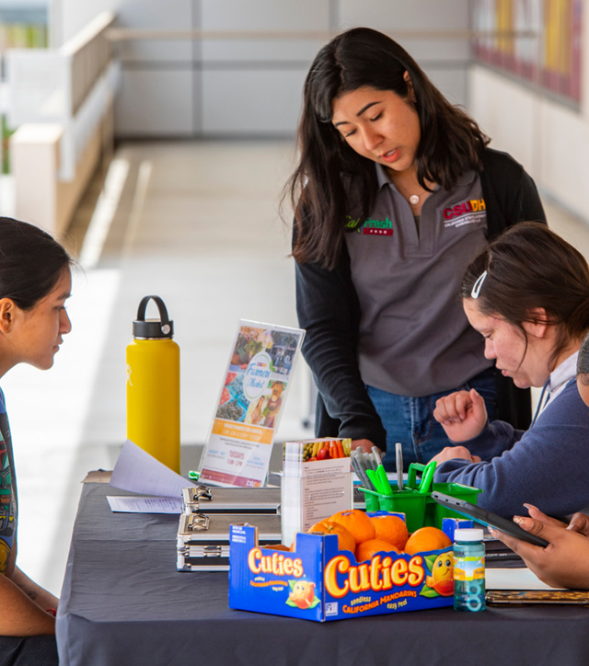
Compassionate Assistance
4. Be an engaged and active listener
5. Clarify next steps and identify potential issues
6. Make sure staff have time to decompress

Slide 33
CalFresh Outreach Program 101
Outreach Strategies

Slide 34
Outreach Strategies
Partnerships
Campus: Financial Aid, EOP(S), DSPS, etc.
Community: Food distribution sites, Family Resource Centers, food banks, K-12 schools and college campuses
Events: Farmers' Markets, Welcome Weeks, etc.
Messaging
Normalizes CalFresh
Include data and stories in your messages

Slide 35
Demystifying CalFresh Food
“Someone else needs it more than I do.”
“When I get a job, I have to pay it all back.”
“My parents don’t want me to apply. They think it will impact my financial aid.”

Slide 36
CalFresh Outreach Program 101
The Application Process & Submission

Slide 37
The Application Process
Outreach
Sharing info with clients about the program and how it can help supplement their grocery budget
Prescreening
Seeing if clients look to be eligible based on basic and student specific eligibility
Application Assistance
Helping clients navigate questions and complete application
Interview and Verifications
Confirming Approval and Benefits Education
Helping clients reschedule as needed, gathering proper verifications (proof of exemptions, etc.)
Education on how/where to use benefits, and how to maintain benefits long term

Slide 38
Application Submission Options
Community Based Organization (CBO) GetCalFresh.org portal
Assisted: On behalf of the client through the assistor CBO portal
Referred: Direct clients to your site’s referral URL (ex: https://www.getcalfresh.org/?source=XXXX)
Will be able to track these applications
General website
By directing potential applicants to the GetCalFresh.org page
Will not be able to track these applications
Paper
When technology/internet access is not a viable option
Can track through Scope of Work Activity Log if on our contract

Slide 39
Demo.GetCalFresh.org

Slide 40
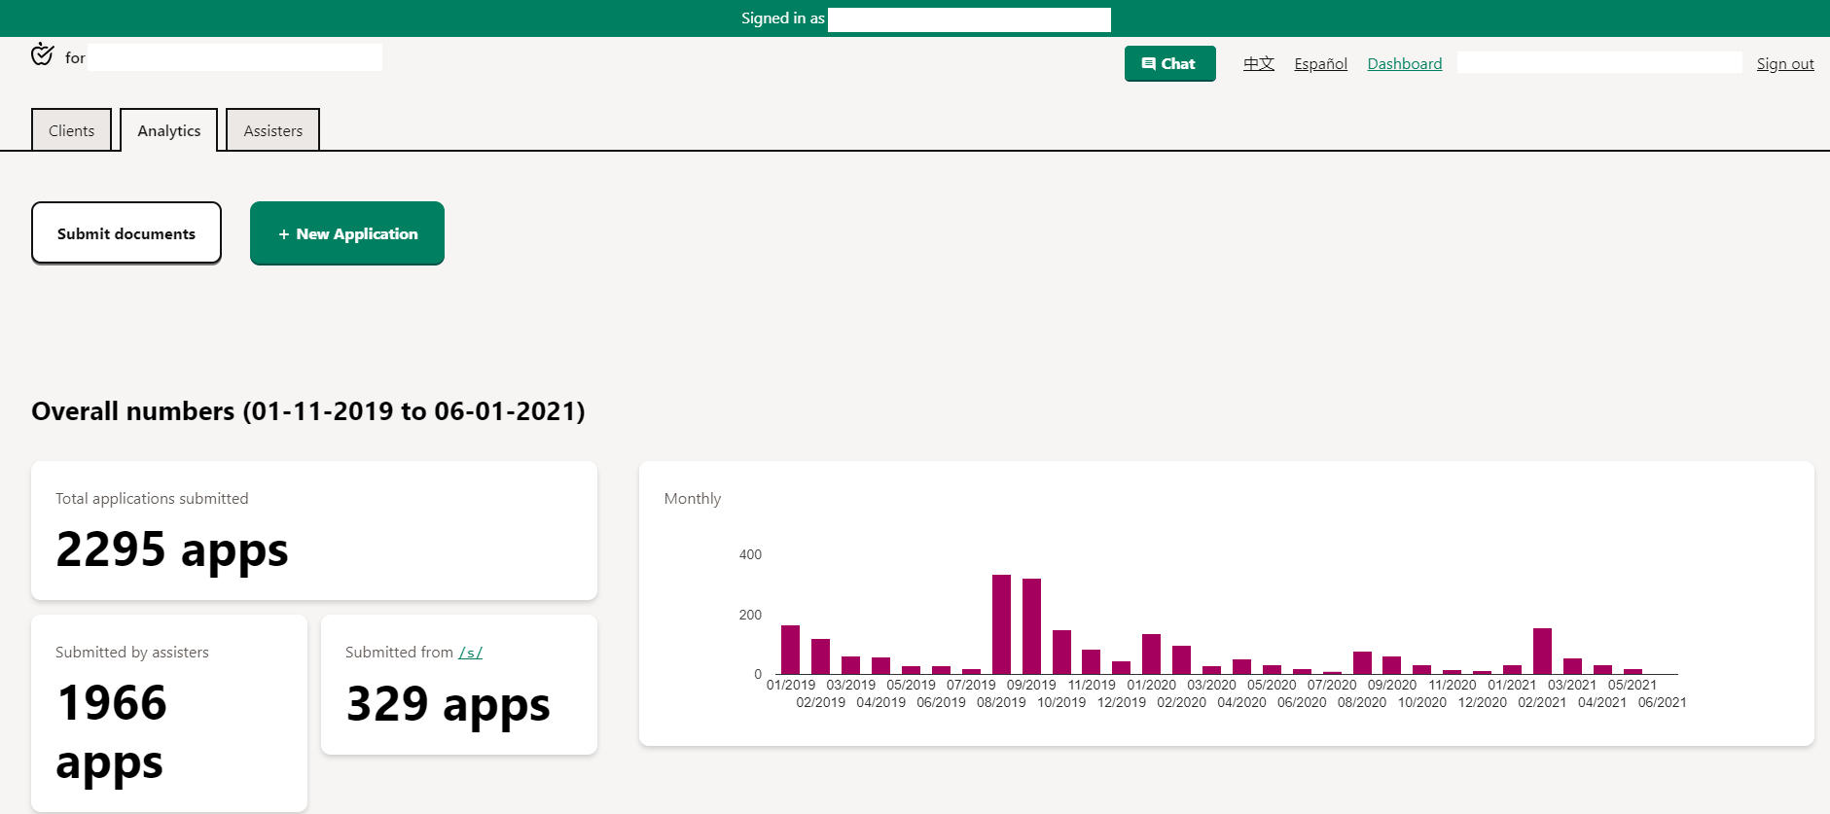
GetCalFresh.org Dashboard

Slide 41
Interviews
Interviews are typically over the phone to confirm household composition and other info
County schedules interview
Client will be notified through mail
Client can reschedule interview
Verification requested after interview

Slide 42
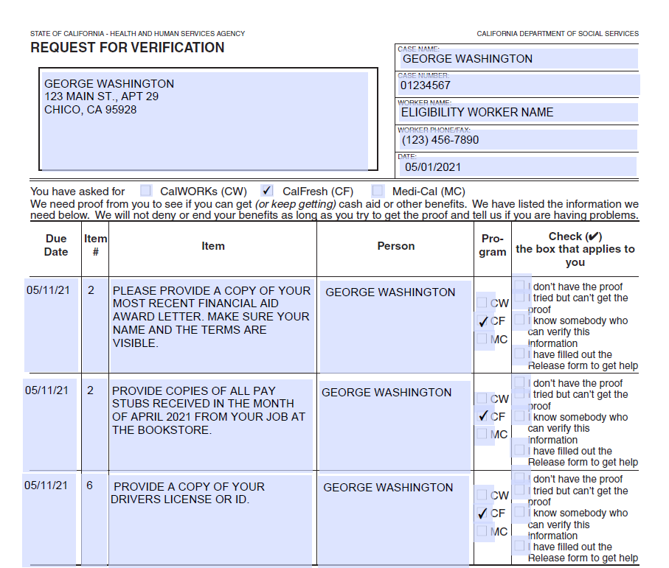
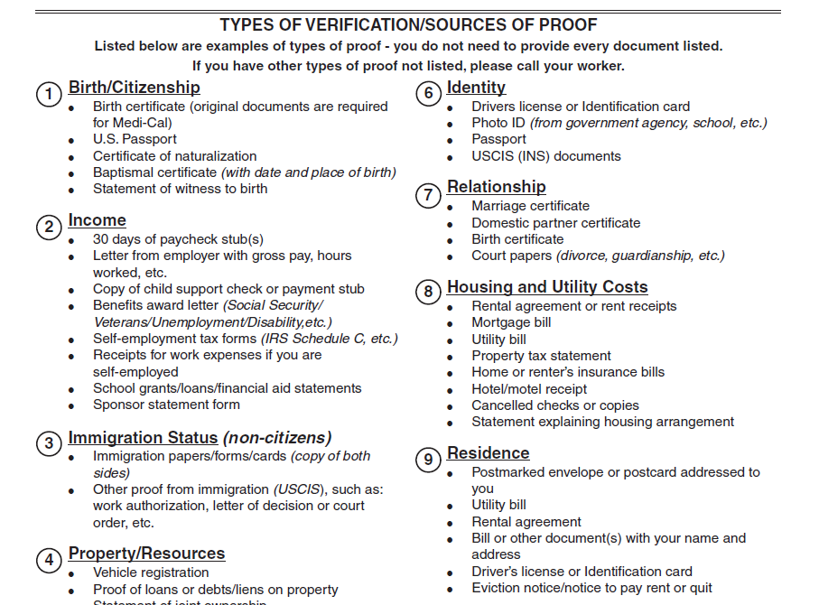
Request for Verification

Slide 43
Maintaining Benefits
Clients are required to complete the following in order to continue to receive benefits (timeline and specific requirements vary per household):
Report any key changes to the county ASAP
Semi-Annual Report (SAR 7)
Recertification (RE)

Slide 44
Funded by USDA SNAP, known in California as CalFresh, an equal opportunity provider and employer, and the California Department of Social Services.

