Slide 2
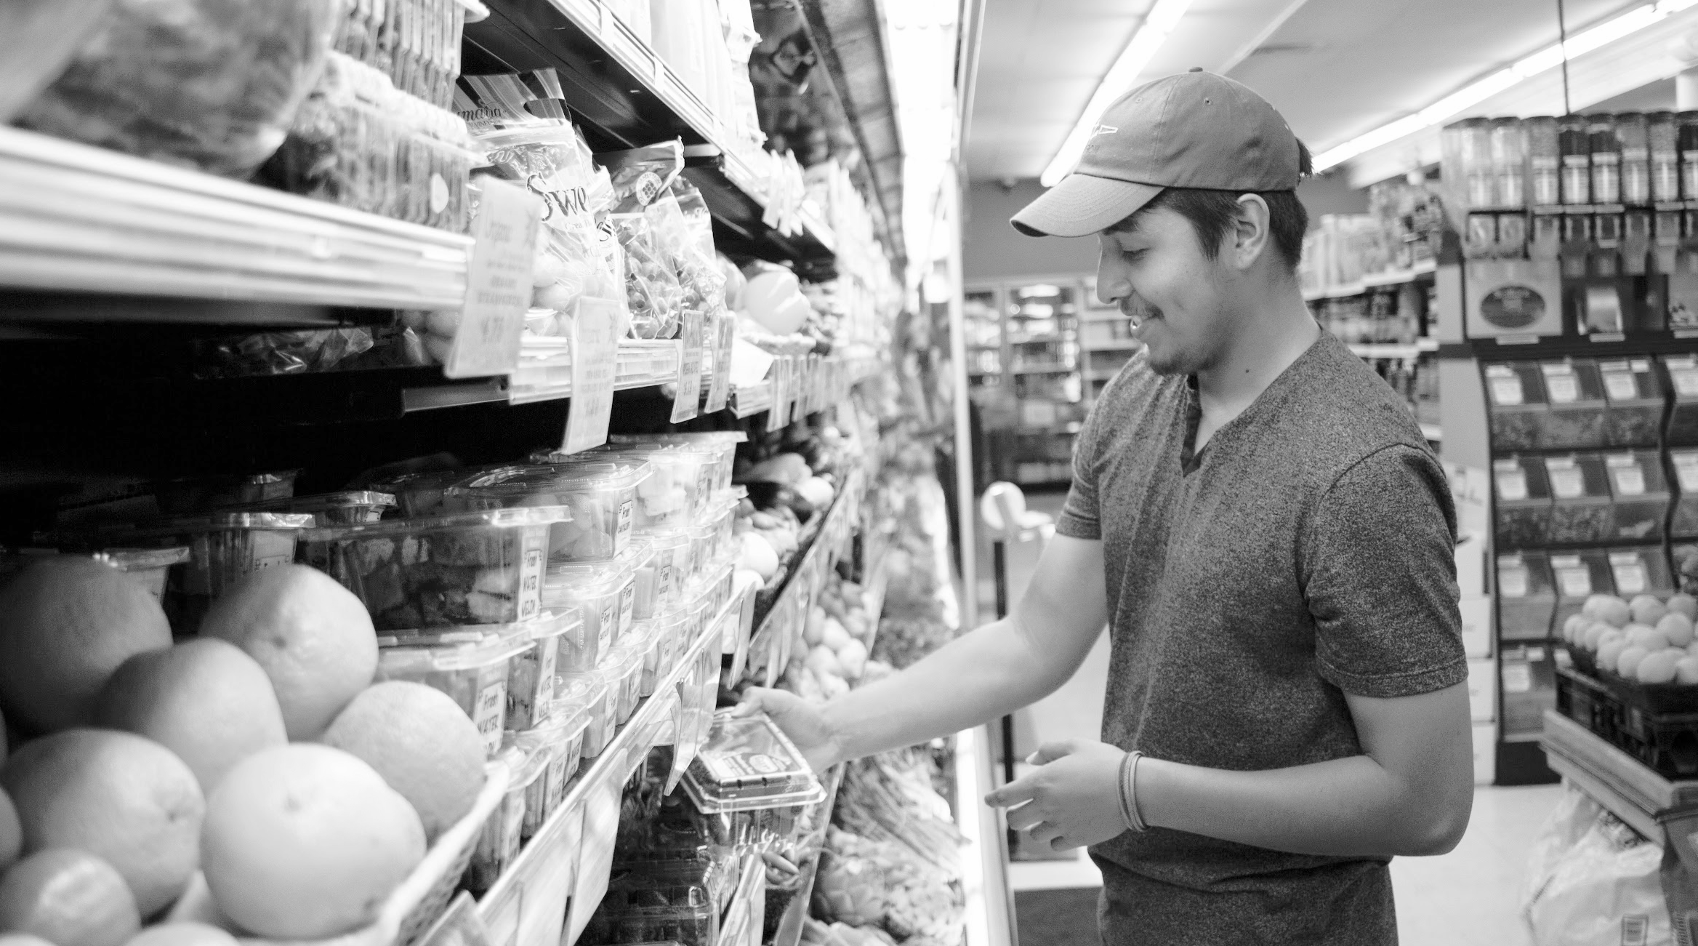
Code for America is a state outreach contractor
that focuses on digital community outreach

Slide 3
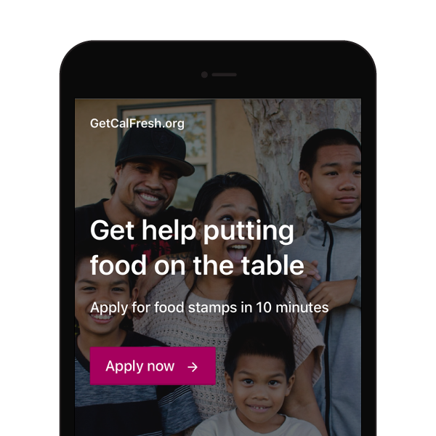
About GetCalFresh
A service provided by Code for America that acts as a digital assister, available at: www.getcalfresh.org (demo here)
It allows anyone to apply for CalFresh using a mobile phone, and guides them through the eligibility process using email, text, and live chat support
No business process changes needed: apps are processed just like any other online applications

Slide 4
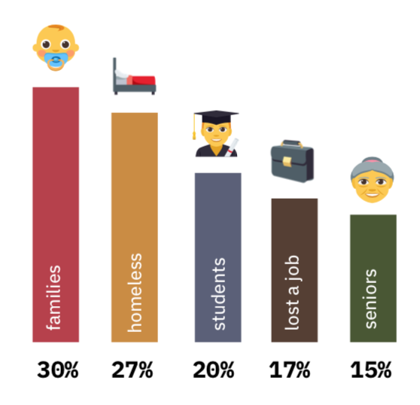
GetCalFresh by the numbers
25,000 applications submitted monthly across 36 counties
Nearly 45% are first time applicants
Less than 0.44% of applicants submit a minimal application
Approval rates vary by county; overall average is 55%
who we help apply

Slide 5
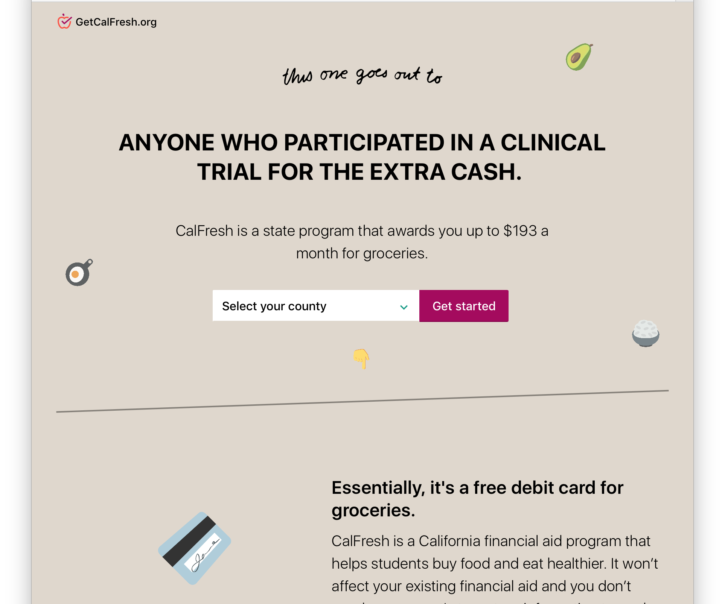
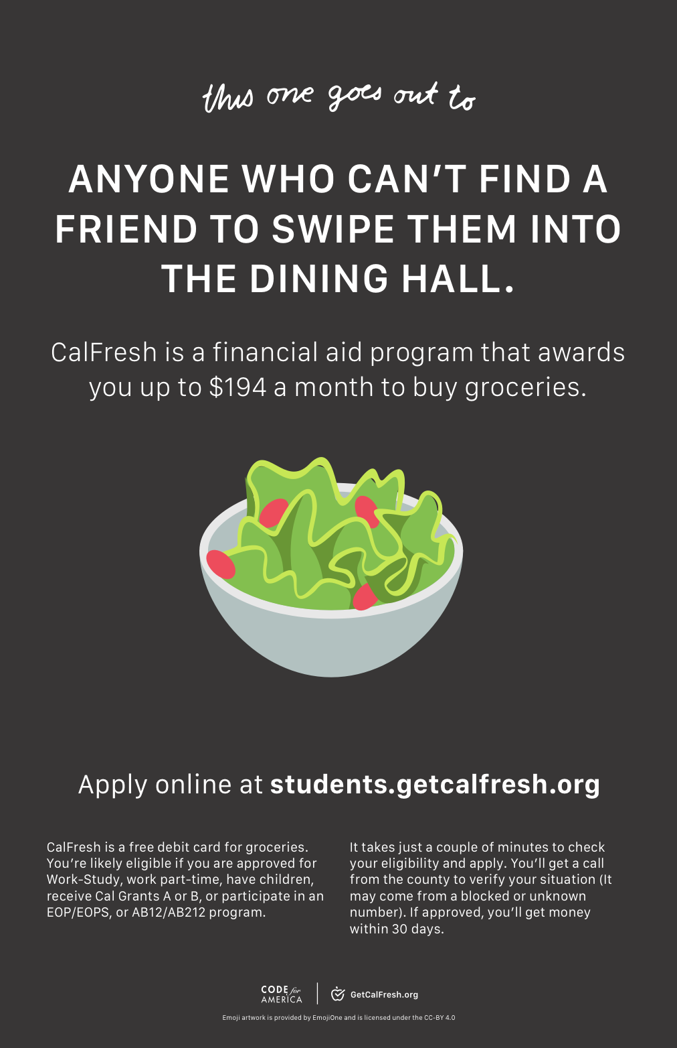
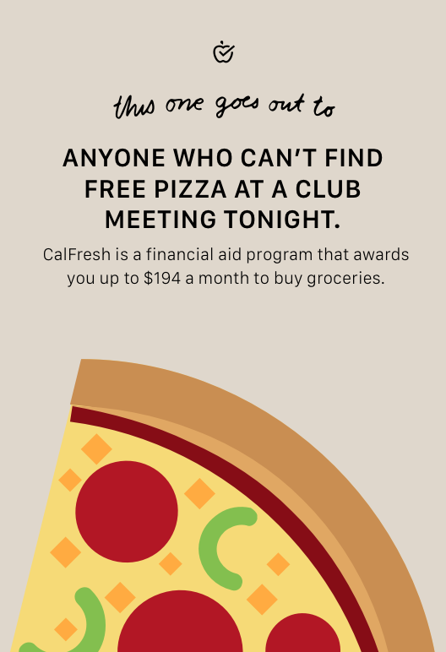
Getting student applicants in the door
students.getcalfresh.org

Slide 6
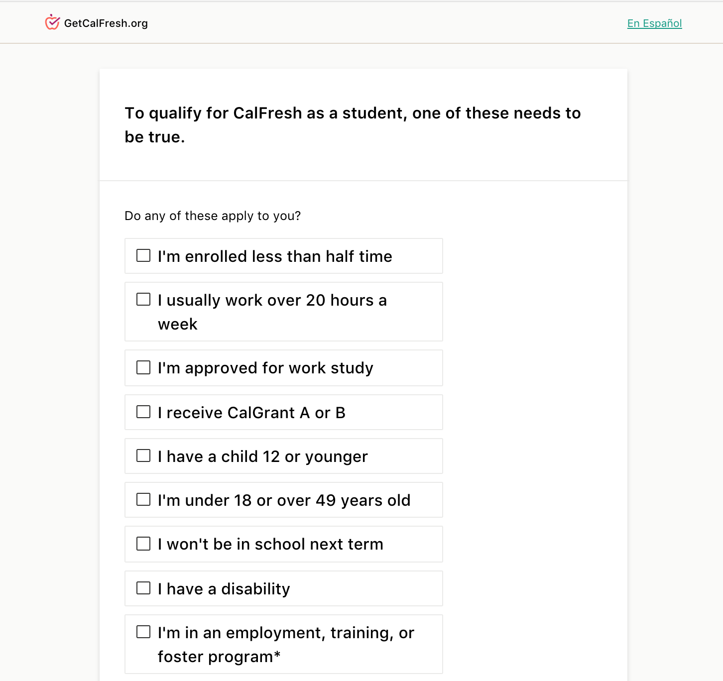
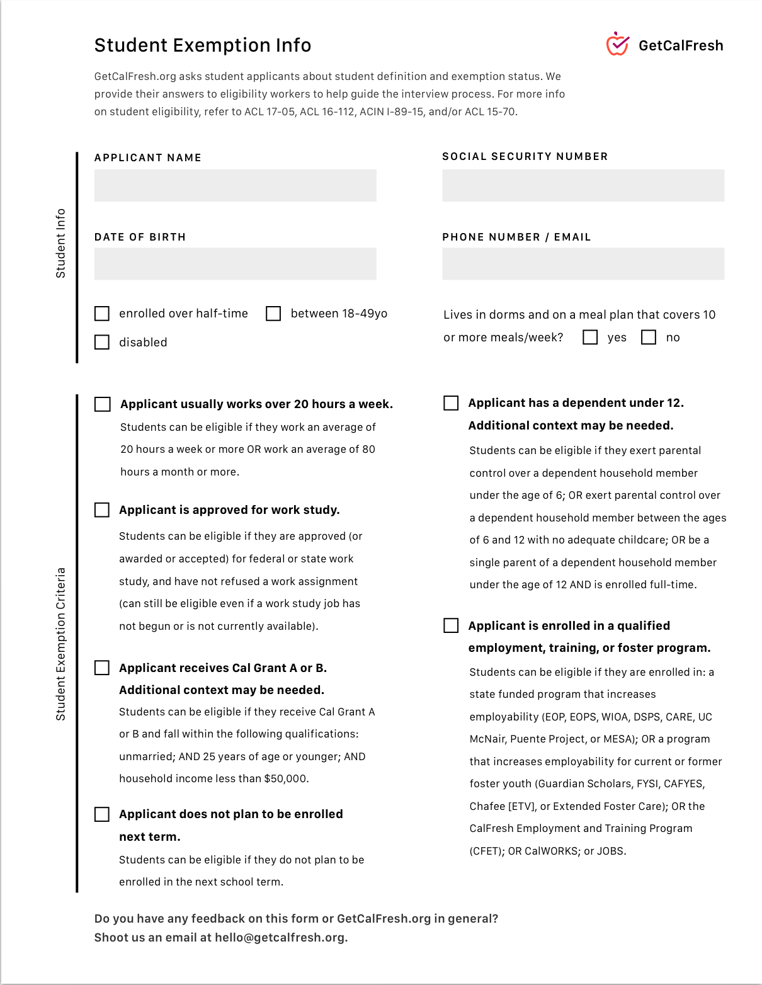
Collect student exemption information
2. Send exemption info as verification to the county

Slide 7
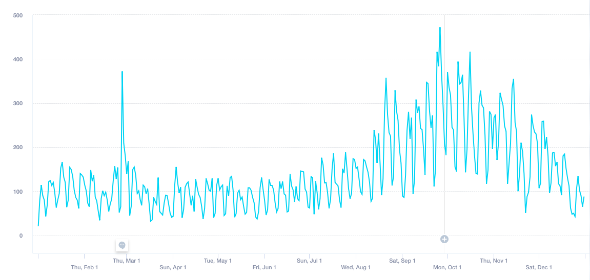
28% of GCF applicants are students
Notes:
More than 52,000 applications statewide

Slide 8
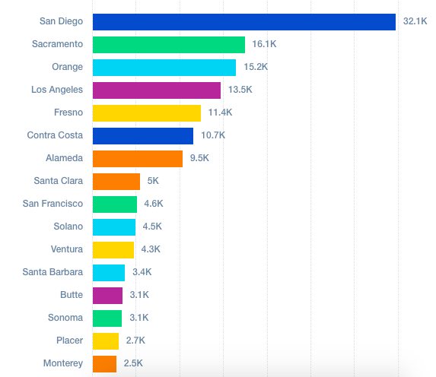
Counties with the most student applicants

Slide 9
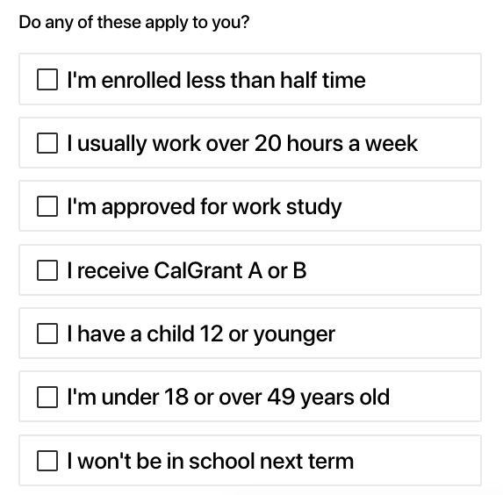
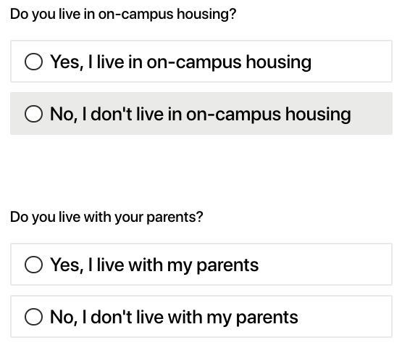
Structured data on common exemptions

Slide 10
Reviewing common exemptions*
 | True | False
Work Study | 1,379 | 697
CalGrant | 1,212 | 864
Employed 20 hrs | 300 | 1,776
Student on Campus Housing | 142 | 1,914
No Exemptions | 118 | 1,938
Employment Training | 105 | 1,971
*data represents one county

Slide 11
Taking a closer look at student approvals*
41.1% approval rate for students (1127 cases)
36.2% approval rate with 1 exemption (469 cases)
42.9% approval rate for work study (231 cases)
36.4% approval rate for CalGrant (121 cases)
28.5% approval rate for working more than 20 hours (88 cases)
49.3% approval rate with 2 exemptions (513 cases)
51.6 % approval rate where one exemption is CalGrant (465 cases)
49.4% approval rate where one exemption is approved for work study (486 cases)
38.8% approval rate where one exemption is employed at least 20 hours (49 cases)
*data represents one county

Slide 13
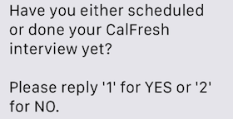
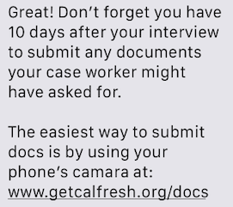
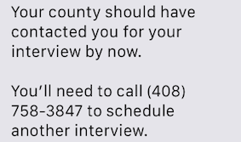
Building feedback loops via texts and emails

Slide 14
Learning about interview no show rates*
65% of students report they had their interview by Day 10
47% are approved
35% of students report they haven’t had their interview by Day 10
Only 38% are approved
How can clients reschedule their interview? What instructions should GCF provide? Does the call center manage intake questions?
*data represents one county

Slide 15
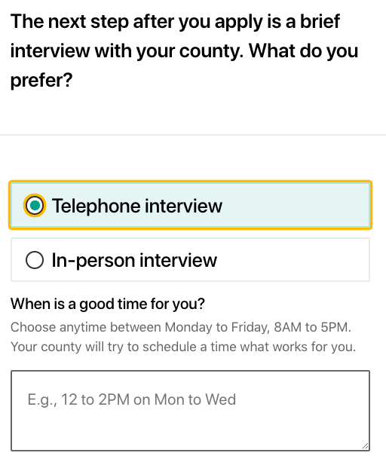
Understanding when students can interview
Only 6% of students say they can interview anytime compared to 20% of other applicants.

Slide 16
Updating county business processes to be inclusive of the student experience
Removing “blocked number”: update county numbers so they appear in the caller ID and advice clients
Test a new interview reschedule line: share a specific number with clients to reschedule their interview and avoid the call center interaction
Explore if we can schedule appointments for the county: update GetCalFresh so clients can pick their appointment time like a doctor’s office
Skip the phone interview: explore if the on-campus worker can take “drop in” interviews

Slide 17
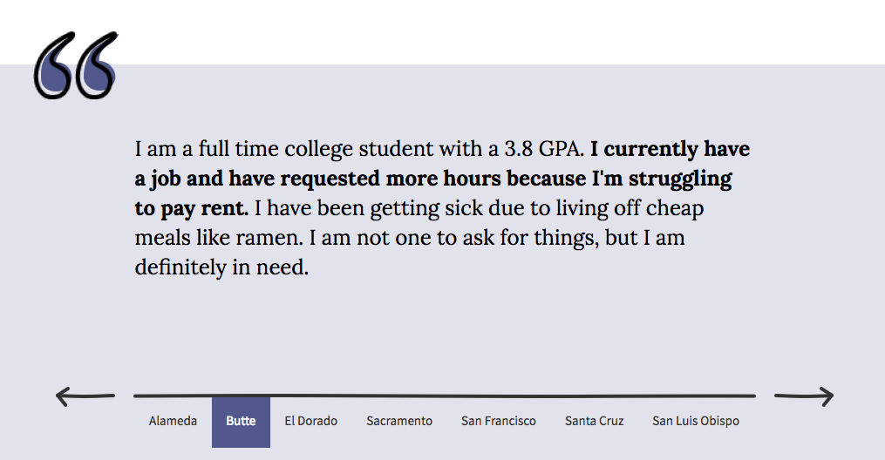
Elevating student stories and addressing stigma
Snapstories.codeforamerica.org

Slide 18
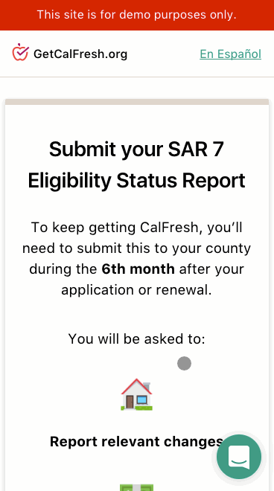
Helping students keep their benefits!
Talk with your county partners
Takes 3-8 minutes to complete
Every form is sign, dated, and proof is attached
Try it yourself: demo.getcalfresh.org/SAR7
Questions: Caitlin@codeforamerica.org

